Slide 1
A proposal for transparization of the future of Iran
How do we create a better future?

Slide 2
What do we all want?
Democracy
Equality
A better future
Woman.Life.Freedom
Help people of Iran
Minimize bloodshed

Slide 3
Common challenges Women.Life.Freedom movement may face:
Uncertainties about the future:
Fear of giving rise to authoritarians similar to in Egypt and other failed revolutions
Fear of a civil war similar to Syria
Not knowing what will happen is frightening
Lack of knowledge/education
Lack of an opposition/coalition
Lack of solid plans for the future
What may happen in the transionary state of the movement?
What plans do the we have for after the revolution?
How are we planning to rebuild Iran?

Slide 4
Research Questions
How could we minimize the uncertainties about the future?
How could we facilitate giving birth to a coalition?
Could we create a leaderless opposition?

Slide 5
Research Question
How could we help to minimize the uncertainties about the future?

Slide 6
Solution: Open Governance
Open governance refers to the principles of transparency, participation, and accountability in decision-making and governing processes.
Notes:
Digital transparency refers to the concept of making information and data about government actions, policies, and decision-making processes readily available and accessible to the public through the use of digital technology. In Taiwan, digital transparency has been promoted as a way to increase government accountability and to improve the efficiency and effectiveness of government services.

Slide 7
Digital Transparency
Transparent financing:
Tracking the new government expenses
Tracking where citizen’s tax may go
Access to all government information
Decision making
Operational methods
Plannings
Open source software
Big Data

Slide 8
Big Data - Big Concern: Privacy Protection & Spying

Slide 9
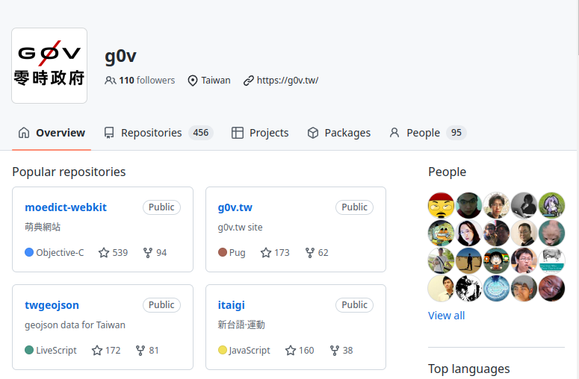
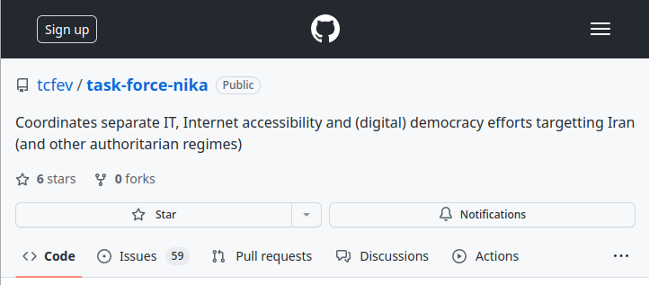
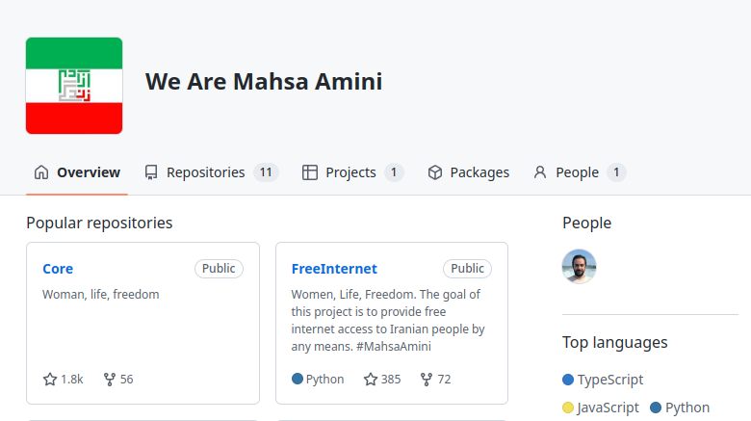
Open Source Context
Open audit of how exactly the software operates
Open collaboration
Examples of successful movements
Transparency
Only open source software can be truly trusted

Slide 10
Open Science - Open Education
Open science is the movement to make scientific research and its dissemination accessible to all levels of society, including amateur and professional background. Open science is transparent and accessible knowledge that is shared and developed through collaborative networks.

Slide 11
Open Source Open Science
The progress of the scientific work is recorded
This introduces the concept of active updating scientific work and admitting scientific work is not error free
Open source science makes it possible for anyone to collaborate and propose new plans for the future of Iran, make a copy of any plans, modify and suggest changes, raise their questions and criticize the existing plans.
All these processes are completely transparent

Slide 12
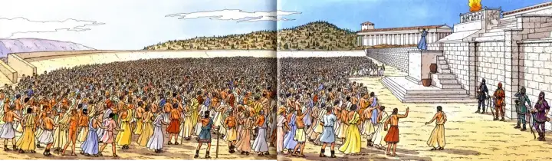
Deliberative Democracy
In deliberative democracy, citizens exchange arguments and consider different claims that are designed to secure the public good. Through this conversation, citizens can come to an agreement and reach consensus about what procedure, action, or policy will best produce the public good.

Slide 13
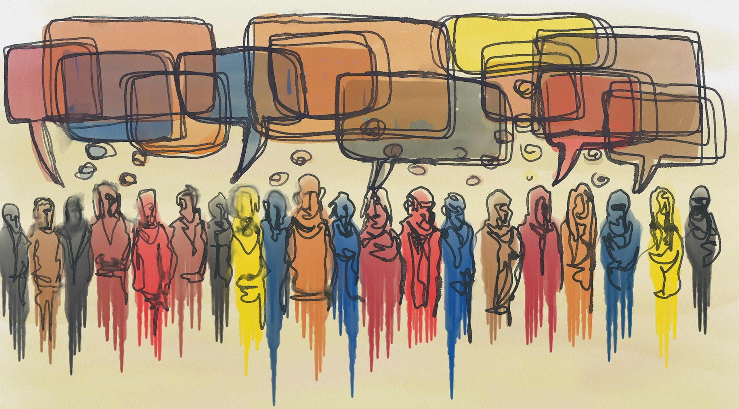
Deliberative/Participatory Digital Democracy
Digital democracy social media platforms can open up governmental affairs with analyzing how large crowd thinks, find solutions, reach consensus and translate the consensus into legalese and make it law.

Slide 14
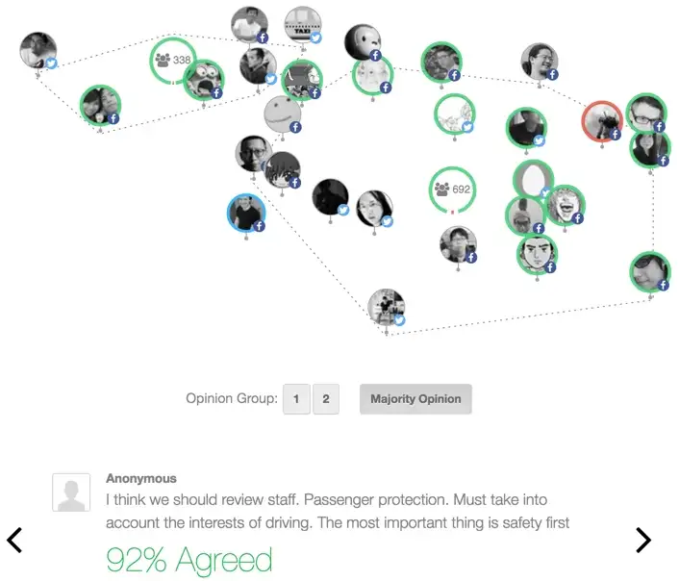
Digital Democracy Platforms: Pol.is
Pol.is is a real-time system for gathering, analyzing and understanding what large groups of people think in their own words, enabled by advanced statistics and machine learning.
This tool has been used to reach consensus on polarized subjects, and the consensus translated to legalese and signed into law

Slide 15
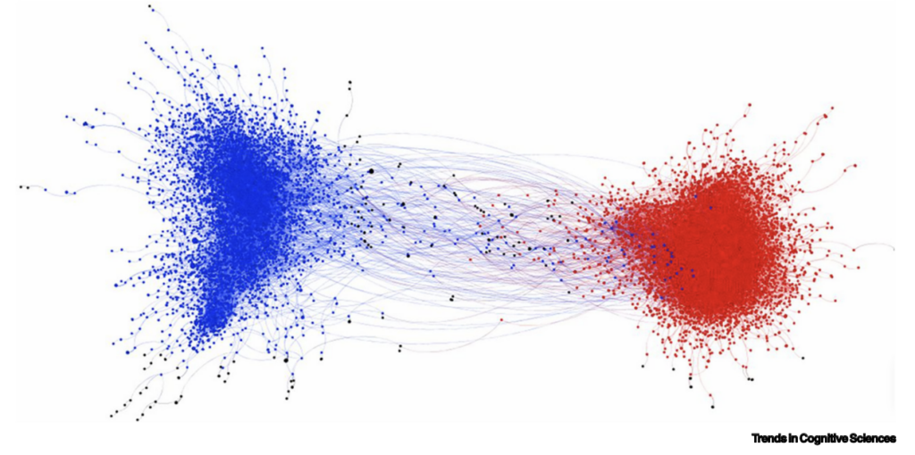
Digital Democratic Media vs Social Media
Similar to a town hall
A troll free platform
Is created with the objective of a safe platform for rational discussions and policy making
Includes deliberative democracy mediums that can scale up to millions
Scientifically Analyzes how large crowd thinks
Creates consensus even on polarized subjects
Similar to bars, nightclubs
People are rude, fight, shout, troll and extreme ends of the society are highlighted
Is created with the objective of more engagement, with clickbaits for ad sells.
Polarizes and divides the society

Slide 16
Digital Democracy - Successful Example
Significat example: Covid Experience In Taiwan:
Zero days of lockdowns - No authoritarian measure like the states and EU.
Open data, and social innovation lab handled misinformation and educated the public.
A ministry of digital whose job is to fight against misinformation and find social innovations for unforeseen events.
Citizens cannot just criticize the governmental actions because they have access to the same data as the governmental officials. You can’t complain about the distribution of masks since you have the same data as well, but you can help the government find better optimal routes.

Slide 17
Digital Democracy - Case Study
Deliberative Polling experiments have been conducted over 100 times in 29 countries.
Unification of Korea, South Korea (August 2011) | Before Deliberation | After Deliberation
Unification is “unnecessary” | 72% | 91%
Unification would be beneficial to South Korea | 48% | 73%
Continuing humanitarian aid to North Korea regardless of the nuclear issue | 43% | 78%
South Korea should posses nuclear weapons | 53% | 34%

Slide 18
Hypothesis
Educating the public and solid plans for the future, implementing open governance, transparency and digital democracy can reduce uncertainties, open up people’s imagination, and give birth to a leaderless opposition.

Slide 19
Coalition - Research Question
How could we facilitate giving birth to a coalition?

Slide 20
Coalition - Research Questions
How many members should the coalition have?
What are the objectives of the coalition?
What are the core principles of the coalition?
Who are the members of the coalition?
How could we ensure transparency in all aspects of the coalition?
What is the selection process for the members of the coalition?
How could this coalition gets legitimacy in representation of the people of Iran with Iranian diaspora members?
How do we involve the people inside Iran to participate in the coalition?
What are the decision-making methods, and operational strategies of this coalition?

Slide 21
Coalition: What are the objectives of the coalition?
Representing people of Iran to the world
Creation of open scientific plans for the future of Iran and conducting case studies of the world for all the governing aspects

Slide 22
Coalition - Open Source Open Science Plan
The formation of this plan could become an open source scientific plan
This adds legitimacy to the plan as it allows anonymous secure participation for the people inside Iran
Open source science creates a possibility of discourse, feedback loop and collaboration
The creator of the plans must answer concerns of the Iranian people

Slide 23
Coalition: How does this coalition gets legitimacy in representation of the people of Iran with the Iranian diaspora members?
Radical transparency in the coalition
Live Streams
Publishing all the digital data
A transparency protocol to ensure openness
Valid data that supports this claim
Could be reported analysis of multiple NPOs
Analysis of social media
Forward voting: Iranian diaspora could forward their friends and relatives vote with the advanced security protocols
Statistical analysis of all of the above to create a valid hypothesis with a good confidence interval

Slide 24
Coalition: Criteria for the members of the coalition?
Representativeness of the people inside Iran
Meritocracy in abilities to conduct case studies of the world and creating open science plans

Slide 25
Coalition: What is the selection process for the members of the coalition?
Open data of resumes, statements and recording of applications
Livestream of interviews between the applicants and Iranians
Open QA between the people and applicants
Analytical reports for the best candidates made by multiple NPOs
Analysis of social media
Forward voting: Iranian diaspora could forward their friends and relatives vote with the advanced security protocols
Statistical analysis of all of above to create a valid hypothesis with a good confidence interval

Slide 26
Thank you for your time! Let’s collaborate in creating a better future plan for Iran I invite you to collaborate in creation and introduction of this plan for the coalition

